Slide 1



KNOW THE CODE
OFFICE OF STUDENT RIGHTS AND RESPONSIBILITIES

Slide 2




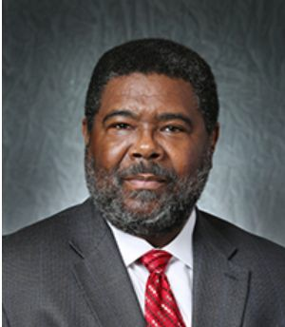
MEET THE DEANS
DEAN C. TAPO
DIRECTOR OF STUDENTS RIGHTS AND RESPONSIBILITIES

Slide 3

MEET THE DEANS
DEAN L. DIXON
ASSISTANT DIRECTOR OF STUDENTS RIGHTS AND RESPONSIBILITIES

Slide 4
WHAT IS THE CODE OF STUDENT CONDUCT?
A CODE OF CONDUCT IS A SET OF RULES OUTLINING THE NORMS,
RULES, AND RESPONSIBILITIES OR PROPER PRACTICES OF AN INDIVIDUAL PARTY OR AN ORGANIZATION. THE PURPOSE OF THIS CODE IS TO OUTLINE STANDARDS OF CONDUCT APPROPRIATE FOR STUDENTS AT THE UNIVERSITY OF LOUISIANA AT LAFAYETTE.

Slide 5
WHERE DOES THE CODE APPLY?
UL LAFAYETTE STUDENTS CAN BE HELD ACCOUNTABLE FOR A VIOLATION OF THE CODE OF CONDUCT THAT OCCURS ON OR OFF CAMPUS WHEN SUCH A VIOLATION:
  THREATENS THE HEALTH, SAFETY, OR WELFARE OF THE UNIVERSITY COMMUNITY OR ANY MEMBER OF THE UL COMMUNITY;
  IS CONSIDERED TO BE OF SUCH A NATURE THAT IT WOULD NEGATIVELY REFLECT UPON THE STUDENT’S CHARACTER AND APPROPRIATENESS AS A MEMBER OF THE UL
LAFAYETTE STUDENT BODY; ◻ CONSTITUTES A VIOLATION OF LOCAL, STATE OF FEDERAL LAW (INCLUDING ANY ALCOHOL AND/OR DRUG VIOLATIONS AND OTHER REPEAT VIOLATIONS OF ANY SUCH LAW) OR
  IS AN INCIDENT OCCURRING WITHIN UNIVERSITY POLICE’S JURISDICTION AN IS REFERRED TO UNIVERSITY POLICE OR UNIVERSITY OF LOUISIANA AT LAFAYETTE STUDENT CONDUCT OFFICERS.

Slide 6
TO WHOM DOES THE CODE APPLY?
THE CODE SHALL APPLY TO ALL STUDENTS WHO HAVE BEEN ACCEPTED FOR
ADMISSIONS INTO THE UNIVERSITY OF LOUISIANA AT LAFAYETTE, BOTH UNDERGRADUATE AND GRADUATE, AND ALL UNIVERSITY AFFILIATED STUDENT ORGANIZATIONS, VISITORS, AND GUEST. FOR THE PURPOSE OF STUDENT CONDUCT, THE UNIVERSITY CONSIDERS AN INDIVIDUAL TO BE A STUDENT WHEN AN OFFER OF ADMISSION HAS BEEN EXTENDED AND THEREAFTER AS LONG AS THE STUDENT HAS A CONTINUING EDUCATIONAL INTEREST IN THE UNIVERSITY. UL STUDENTS SHALL ALSO BE HELD TO COMPLIANCE OF ANY OTHER REGULATIONS THAT HAVE BEEN PROPERLY ADOPTED BY THE UNIVERSITY

Slide 7
Classroom Disruption
“Disruption,” as applied to the academic setting, means behavior that a reasonable faculty member would view as interfering with normal academic functions.
Examples include, but are not limited to:
Persistently speaking without being recognized.
Interrupting other speakers.
Behavior that distracts the class from the subject matter or discussion.
In extreme cases, physical threats, harassing behavior or personal insults.
Refusal to comply with faculty direction.
**Although some disruptive students may have emotional or mental disorders and thus are disabled and protected under the Rehabilitation Act (ADA), they are held to the same standards of conduct as all other students.**

Slide 8
Tips to Prevent Classroom Disruptions
The best time to deal with disruption is before it begins. Faculty can take steps to reduce the likelihood of disruptive behaviors in the classroom.
Explicitly state expectations for conduct in the syllabus. Include specifics, such as “turn off electronic devices and cell phones before entering the classroom.”
Explain the consequences for inappropriate behavior.
Review these expectations with students during the first class meeting
Model respectful communication with your students
Facilitate respectful exchange of ideas among your students.
Respond to problems consistently and in a timely manner
In cases of IMMEDIATE THREAT to you or others, immediately call University Police at
337-482-6447.

Slide 9
Academic Dishonesty
Cheating
Cheating, in the context of academic matters, is the term broadly used to describe all acts of dishonesty committed in taking
tests or examinations and in preparing assignments. Cheating includes but is not limited to such practices as gaining help
from another person, using crib notes, relying on a calculator or any current technology if such aids have been forbidden.
Preparing an assignment in consultation with another person when the instructor expects the work to be done independently
is also considered cheating. In other words, cheating occurs when a student makes use of any unauthorized aids or materials. Furthermore, any student who provides unauthorized assistance in academic work is also guilty of cheating.
Plagiarism
Plagiarism is the use of unacknowledged materials in the preparation of assignments. Thus, the student must take care to
avoid plagiarism by research or term papers, art projects, architectural designs, musical compositions, science reports, laboratory experiments, and the like.

Slide 10
The Process for Reporting Academic Dishonesty
Those of us in the profession of education agree that cheating incidents make people nervous: the people reporting it, the people confronting it, all those involved. Yet knowing the statistics, we must be proactive in trying to curb Academic Dishonesty.
Cheating Handled within the department:
If you receive a report of a student cheating or plagiarizing, you have the authority as a faculty member to investigate and/or collect any evidence and give an appropriate penalty.
If you catch a student who has either cheated or plagiarized, the faculty may assign a "zero" for the assignment/test in question or assign an F in the course.
We request that whenever you sanction a student for cheating or plagiarism, you notify our office via the Academic Dishonesty Report in the Maxient System (so that we may keep records in the event the student ever cheats again during his tenure at the University.)

Slide 11
The Process for Reporting Academic Dishonesty (Cont.)
Cheating handled in conjunction with Dean of Students Office.
If you choose this route, our office will assist you in any manner you choose.
We will either advise or assist you in assessing sanctions.
We could charge the student with a violation of the Code of Student Conduct and place him on sanctions via the University's Letter of Sanctions.
In extreme cases where cheating warrants dismissal, our office would charge the student to appear before
the Student Discipline Committee and request dismissal/suspension from the University.

Slide 12
Tips to Be Proactive about Academic Dishonesty
State policies and penalties on syllabus (don’t just copy a handout)
Communicate to your students what you expect and how you will handle academic dishonesty the first class session.
Make arrangements to prevent cheating (i.e. test seating, moving around the room, making eye contact with students who look up, etc.)

Slide 13
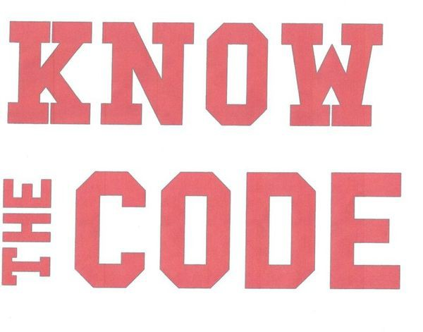
Questions

Slide 14




Slide 15
CONTACT US
OFFICE OF STUDENT RIGHTS AND RESPONSIBILITIES
UNIVERSITY OF LOUISIANA AT LAFAYETTE STUDENT UNION DEAN OF STUDENTS SUITE ROOM 169
LAFAYETTE, LA 70504
OFFICE: (337) 482-6373 FAX: (337) 482-1167 EMAIL: STUDENTRIGHTS.RESPONSIBILITIES@LOUISIANA.EDU

