Slide 1
New Faculty Orientation: Distance Learning at UL Lafayette
August 15, 2023
distancelearning@louisiana.edu

Slide 2
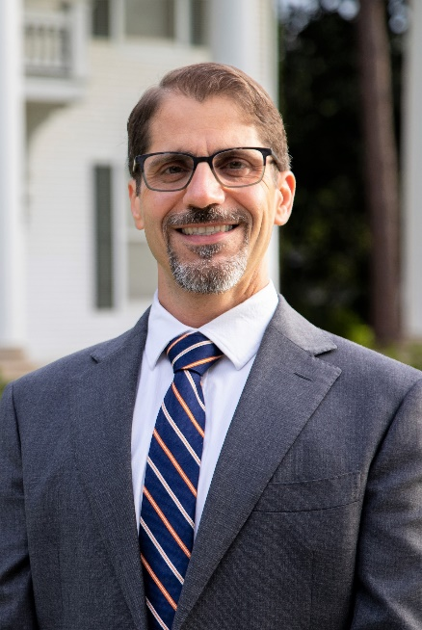
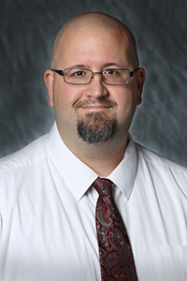
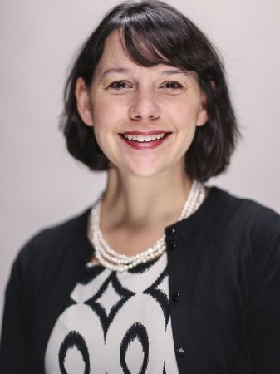
Presenters
Dr. Francesco Crocco
Assistant Director for Instructional Support
Michael Williams
Senior Instructional Technologist
Dr. Alise Hagan
Senior Instructional Designer

Slide 3
Agenda
Introduction to Distance Learning
Distance Learning Technology
Distance Learning Services

Slide 4
Introduction to Distance Learning

Slide 5
Audience Poll
Have you taught an online or hybrid course?
Notes:
Online learning is a growing recruitment, retention and completion strategy.

Slide 6
Three Course Modalities @ UL
Standard Course
Meets face-to-face on campus
Has assigned classroom space and hours
Mostly synchronous, but can be enhanced by online technology to enable asynchronous activity
Hybrid Course
Meets 50-99% online (using our Moodle LMS)
Has assigned classroom space and hours
Combination of synchronous and asynchronous activity
Online Course
Meets 100% online (using our Moodle LMS)
No assigned classroom space and hours
Mostly asynchronous, but can have synchronous activities
Notes:
Online learning is a growing recruitment, retention and completion strategy.

Slide 7
18 Online Programs & Certificates
Online Undergraduate Programs
BS in Business Administration
BS in Kinesiology
BS in Health Services Administration
RN to BSN
BS in General Studies
Graduate Certificate Programs
Cardiovascular Nursing
Instructional Coaching
Population Health
Healthcare Administration
Psychiatric Mental Health Nurse Practitioner
Online Graduate Programs
Masters of Business Administration
Master of Education in Curriculum & Instruction
Master of Education in Educational Leadership (hybrid)
Master of Nursing
MS in Accounting
MS in Informatics
MS in Systems Technology
Doctor of Nursing Practice
Notes:
Online learning is a growing recruitment, retention and completion strategy.

Slide 8
Students Taking DL Courses
7,946
students took 1+ online or hybrid courses
in Fall 2021
Notes:
We now have more than 8,000 students taking online or hybrid courses at our University.
Our students like having the option of blending their schedules. Last fall, 54% of University students were enrolled in at least one online or hybrid course.

Slide 9
Online Program Students
2,242
Students learning
entirely online
7,946 Total Students
Fall 2021
Notes:
Of those students, 2,500 were enrolled in online programs, which is 16% of the University’s enrollment.
We continue to expand access to higher education for working adults. We now have 17 online programs.

Slide 10
Online & Hybrid Sections
Notes:
Last fall, our ULearn Certified faculty taught 570 online and hybrid course sections.

Slide 11
Advantages of Teaching Online
Work Flexibility
Professional development opportunities
Support for course design
Access to Innovative instructional technology
Department E-Learning Funds
Notes:
Online learning is a growing recruitment, retention and completion strategy.

Slide 12
Distance Learning Technology

Slide 13
Learning Management System
Moodle can be used for:
Delivery of online and hybrid course content.
Submission and grading of assignments.
Quizzes and exams.
Discussion forums.
Collaborative learning activities.
We can help you with:
Instructional design strategies.
Enhancing accessibility.
Student engagement features.
Solving technical issues.
Integration with other EduTools.
Learning Management System (LMS)

Slide 14
Supported EduTools
Distance Learning Supported EduTools

Slide 15
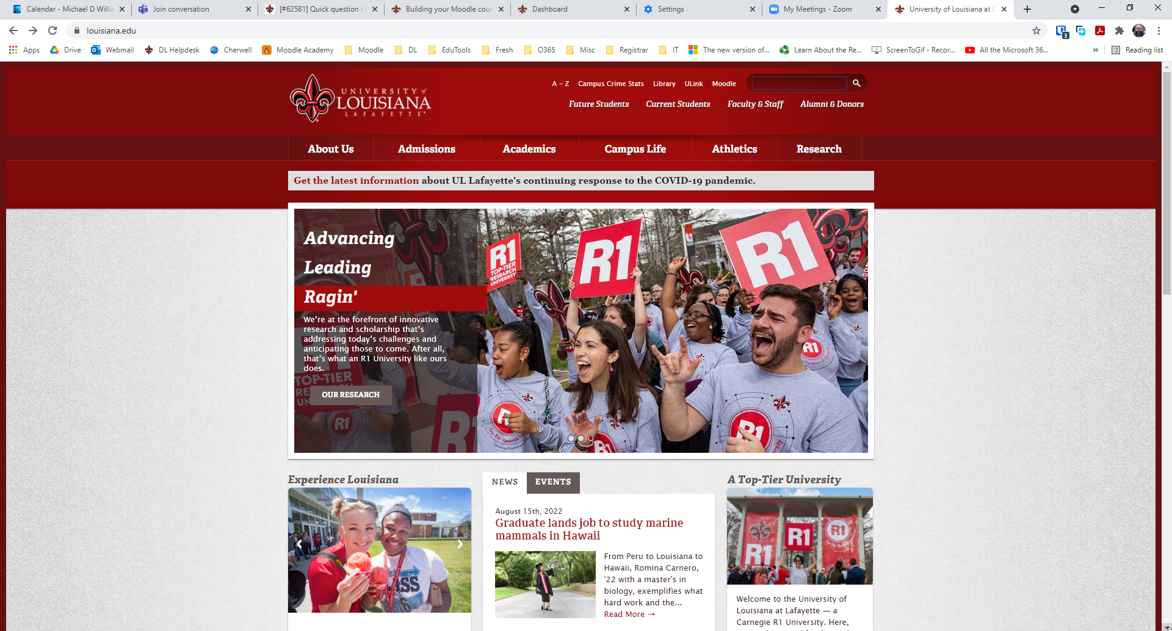
Accessing Moodle from Website

Slide 16
Accessing Moodle from Website

Slide 17
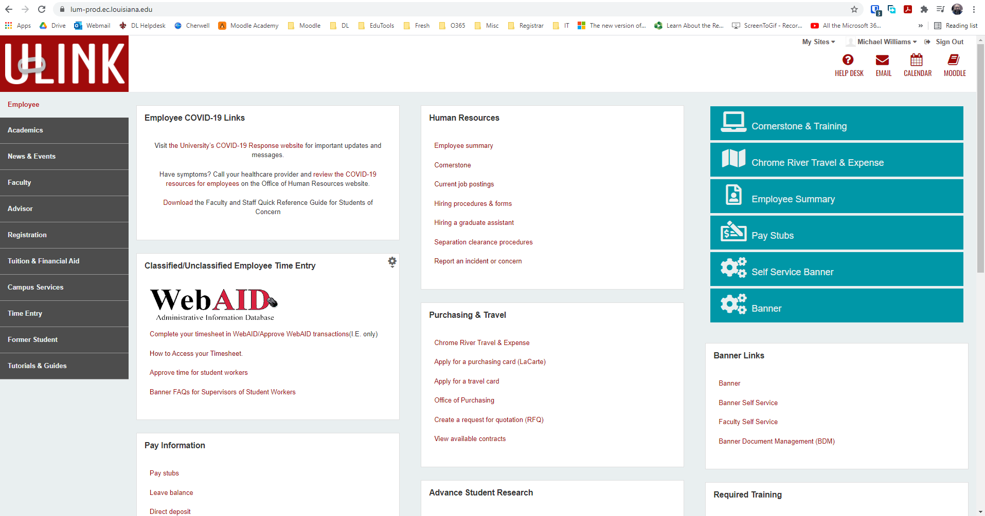
Accessing Moodle from ULink

Slide 18
Accessing Moodle from ULink

Slide 19
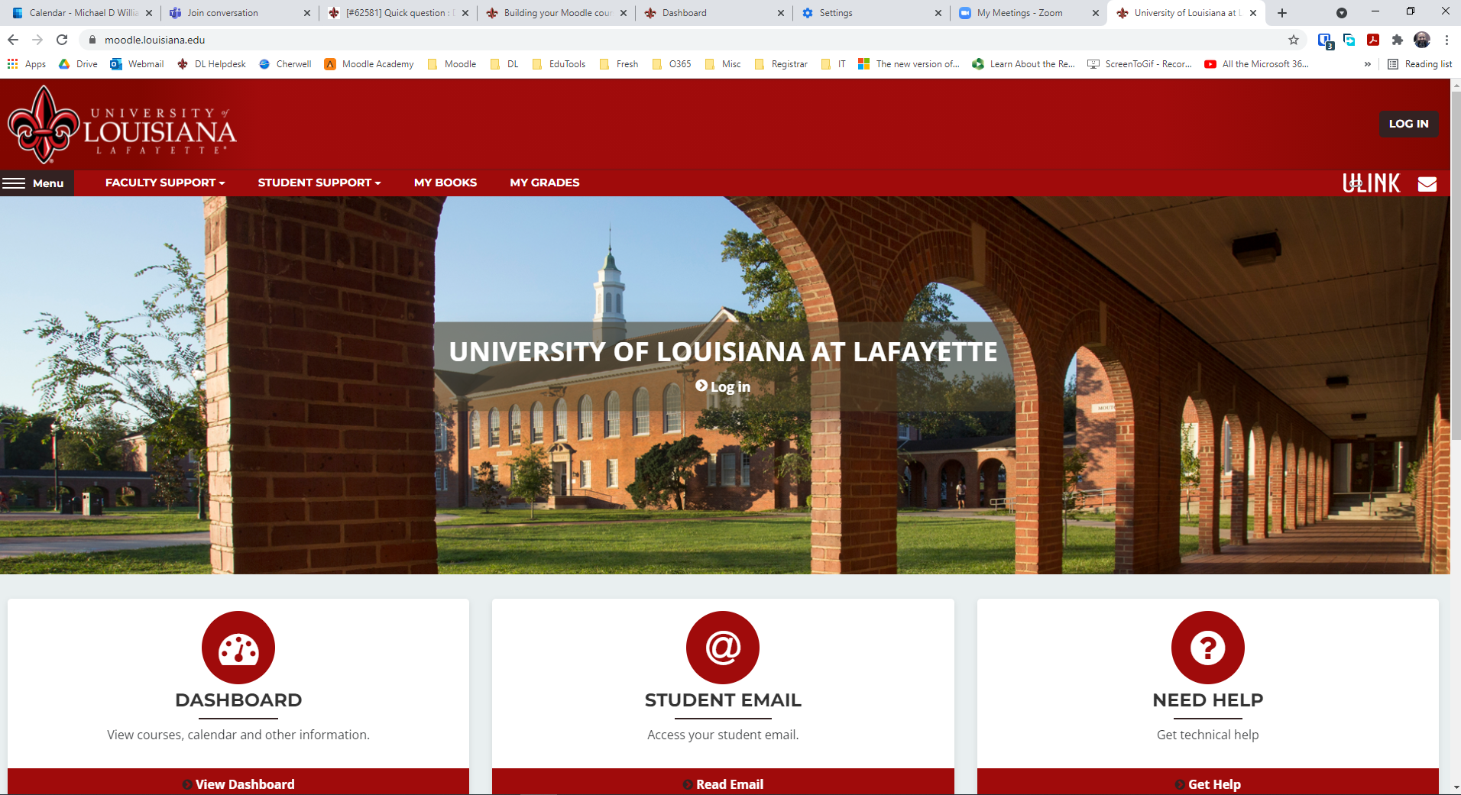
Accessing Moodle Directly

Slide 20
Accessing Moodle Directly

Slide 21
Accessing Moodle Directly

Slide 22
Accessing Moodle Directly

Slide 23
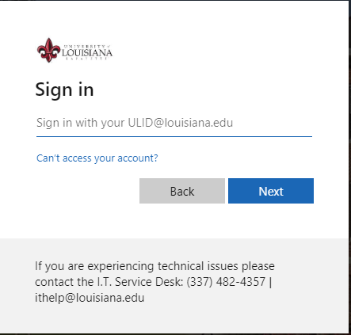
University Login Credentials

Slide 24
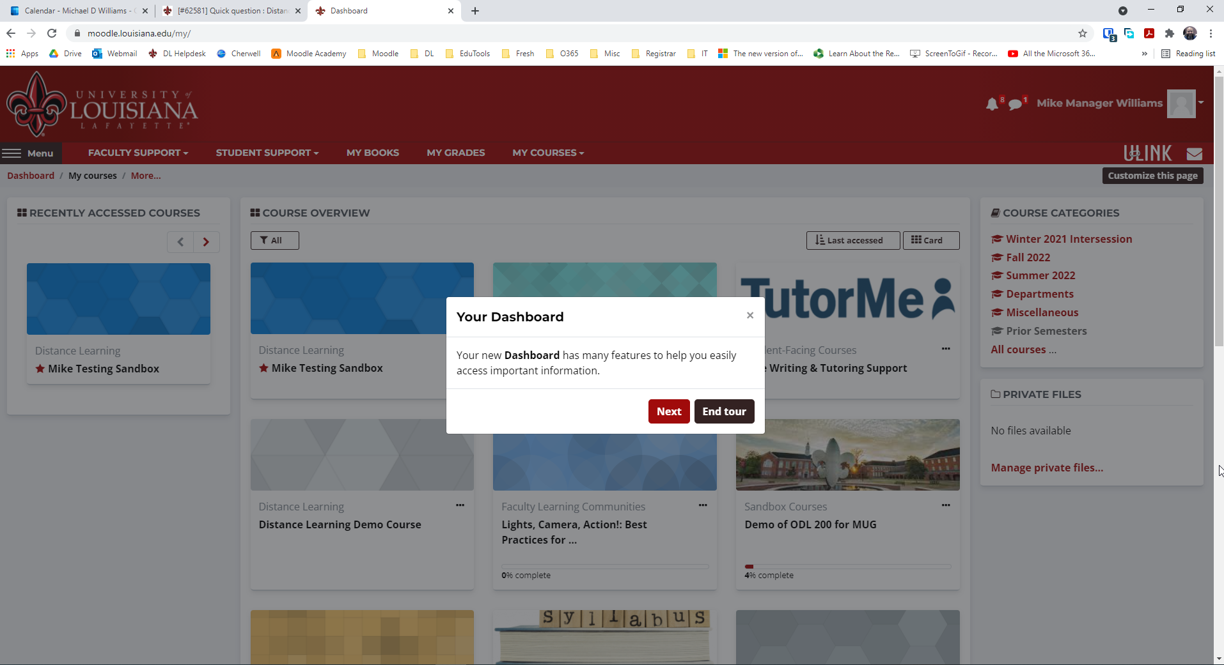
Moodle Dashboard

Slide 25
Moodle Dashboard

Slide 26
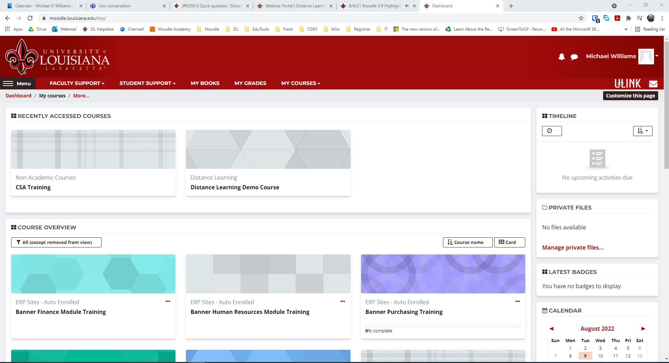
Moodle Dashboard

Slide 27
Moodle Dashboard

Slide 28
Moodle Dashboard

Slide 29
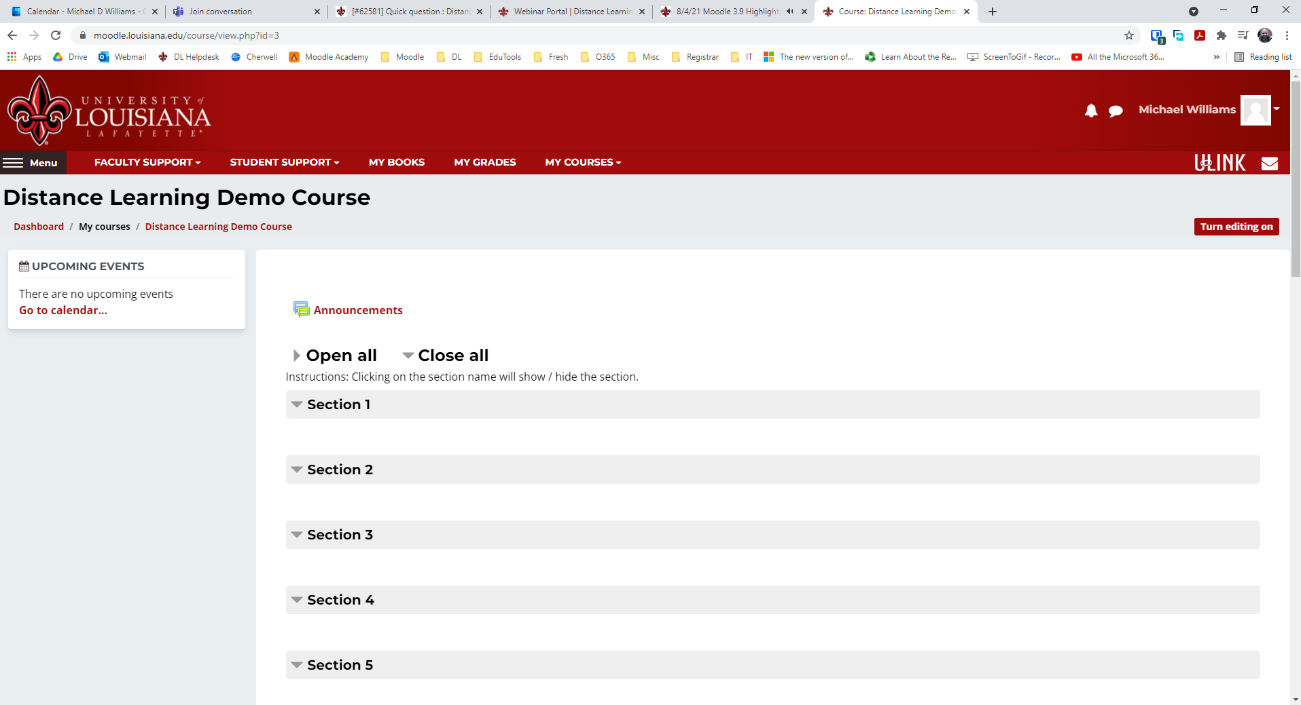
New Course

Slide 30
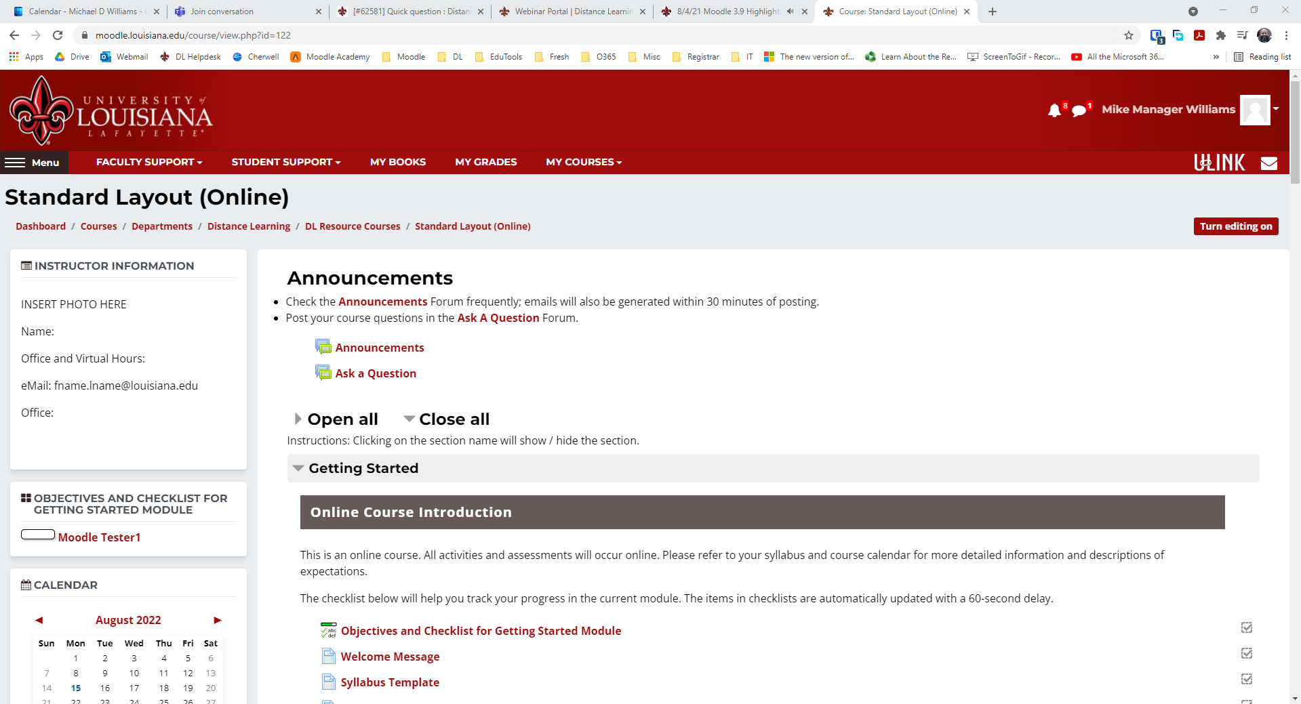
Standard Moodle Layout

Slide 31
Moodle Dashboard

Slide 32
Moodle Toolbar

Slide 33
Faculty Support Menu

Slide 34
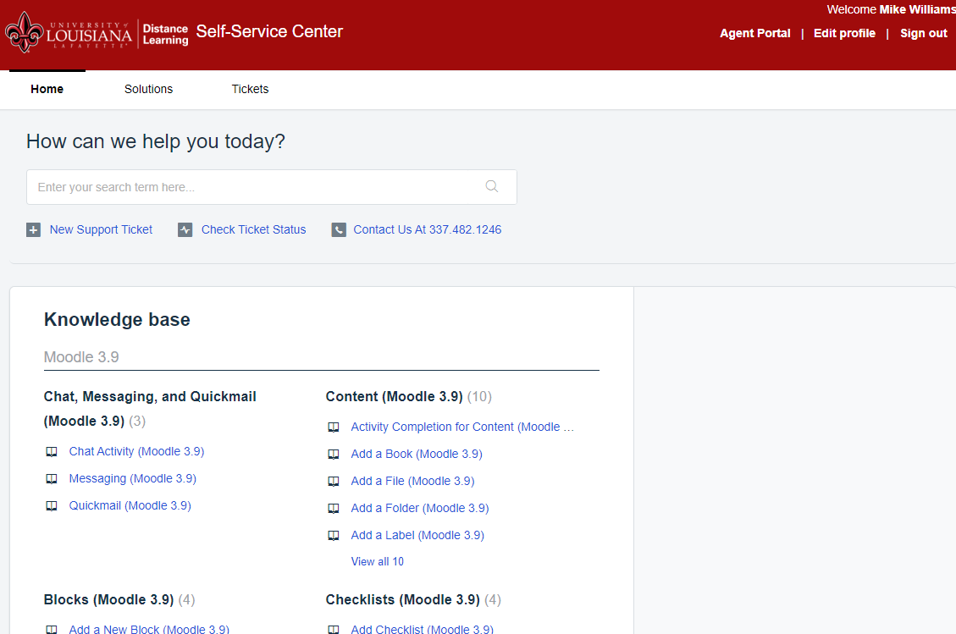
Distance Learning Self-Service

Slide 35
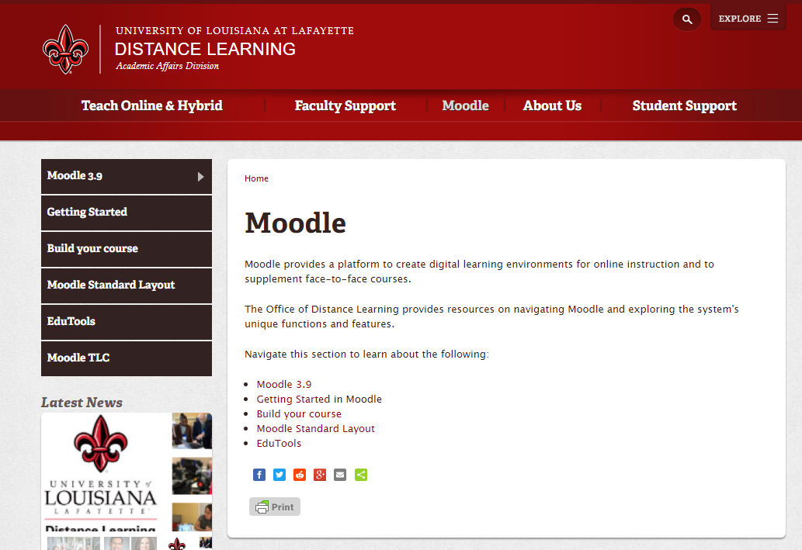
Distance Learning Website

Slide 36
Distance Learning Website

Slide 37
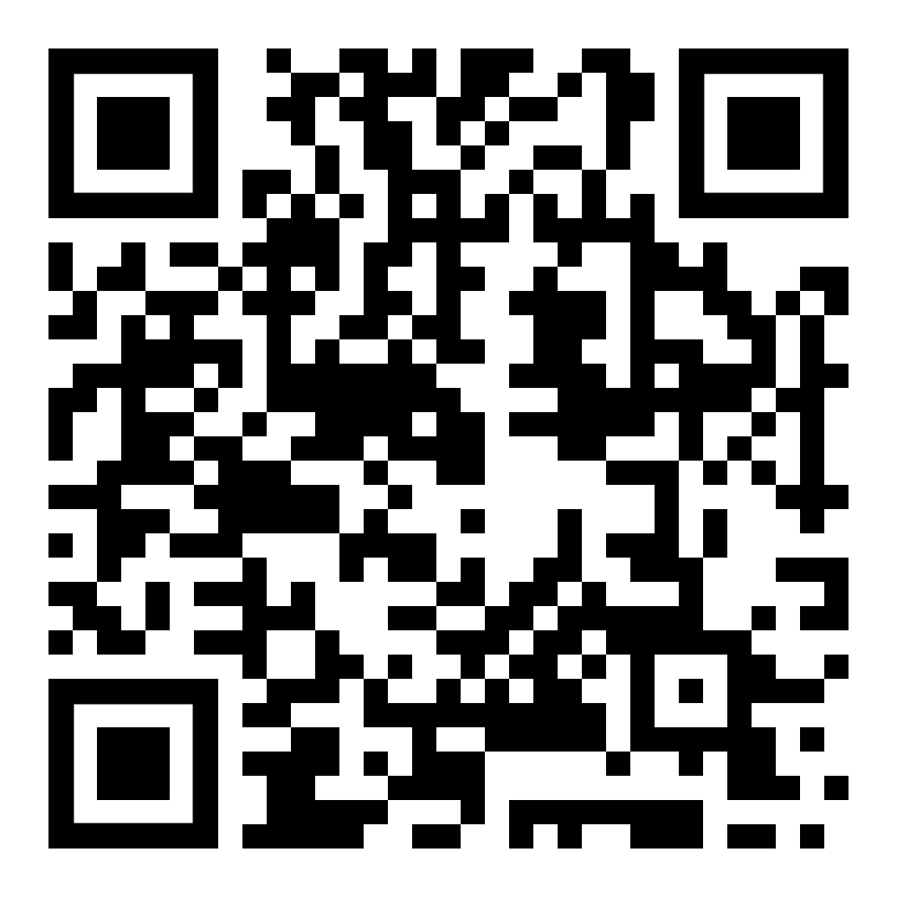
MTLC
Join the Moodle Teaching and Learning Community on Teams!
Community discussion and feedback
Moodle updates and announcements
Tips, tricks, and strategies
Everyone needs a little Moodle TLC!

Slide 38
Distance Learning Services

Slide 39
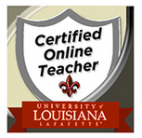
ULearn Certifications
Workshop Series leads to ULearn Certified Online Teacher
Ideal for faculty who will be teaching online for the first time or teaching a course already designed
Series of 4 required workshops designed to give you an online student experience
Workshops are fully online; some self-paced and some facilitated
Expedited route to certification
Course Design Experience leads to ULearn Certified Course Designer
Ideal for faculty who intend to create and teach a fully online or hybrid course
Series of 3 workshops including ODL 310 in which you build your course in six phases with the guidance of an Instructional Designer
Open-enrollment
Portfolio leads to either ULearn Certification
Ideal for faculty who have completed training to teach online at another institution or who have significant online teaching experience
Notes:
Our growth in online learning is, in part, due to the efforts of several academic departments across campus, including 344 faculty members who have been certified to teach online and hybrid courses.

Slide 40
ULearn Certified Faculty – Join Us!
= 411
460
= 138
Unique
ULearn Faculty
= 89
Notes:
Our growth in online learning is, in part, due to the efforts of several academic departments across campus, including 344 faculty members who have been certified to teach online and hybrid courses.

Slide 41
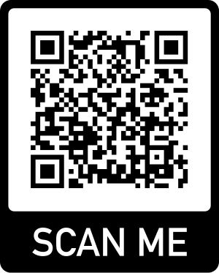
Professional Development
Professional Development Courses
Distance Learning Week
Tech Tool Expo
10 Minute Tech Talks
Webinars (current topics like AI)
Faculty Learning Communities
Scan for upcoming Professional Development!
Notes:
Online learning is a growing recruitment, retention and completion strategy.

Slide 42
Faculty Learning Communities 2022-23
Enhancing Learner-Content Interaction with H5P
Mission: To learn how to design interactive course content with H5P and create content to enhance online courses taught in Spring 2023 as part of a funded research study.
Using Microsoft Teams to Enhance Instruction
Mission: To explore the practical uses of Microsoft Teams in every aspect of our daily work, including communicating, organizing, scheduling, meeting, and teaching.
Course-Embedded Undergraduate Research Experiences (CUREs) in the Online Environment
Mission: To explore effective tools and strategies for building student research experiences into online courses.
Notes:
Online learning is a growing recruitment, retention and completion strategy.

Slide 43
How to Contact Us
You can reach us by:
Email: distancelearning@louisiana.edu
Phone: 337-482-1246
Website: distancelearning.louisiana.edu
Office Location: Whittington House
Connect with us individually on TEAMS!

Slide 44
Thank You!
Dr. Francesco Crocco
Michael Williams
Dr. Alise Hagan
distancelearning@louisiana.edu

