Slide 3
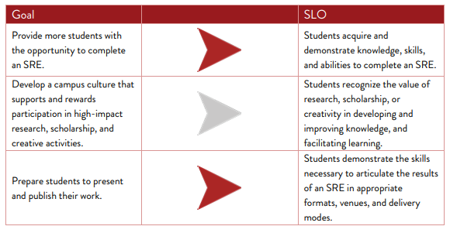
The goals of Advance will lead to Student Learning Outcomes (SLO)

Slide 4
The Advance Student Research Experience (ASRE) Pathways expands research, skills and hands-on experiences for undergraduate students.
The Advance Pathways (Distinction, & Excellence) will increase the quality of students' knowledge and marketable skills in research, creativity, and scholarship.
Students can complete designated courses and co-curricular activities to earn the Advance attribute on their transcript. The completion of Advance Pathways enhances the influence of UL Lafayette's R1 status.
Sherry Krayesky-Self

Slide 5
Advance Pathways | Advance Pathway Basic | Advance Pathway Distinction | Advance Pathway Excellence
Guidelines for Department pathway designs | 12 – 36 credit hours required (4-9 courses) No Co-curricular events allowed | 12-40 credit hours required (4-10 courses) 2-3 Co-curricular events required | 18-40 credit hours required (6-10 courses) 4-5 Co-curricular events required
There was a trend discovered during the pilot program. UL Lafayette has adopted these guidelines for the Advance SRE Pathways

Slide 6
Departments and Colleges in Pilot Group I
Biology Science
History COLA
Psychology COLA
Architecture & Design Arts
Chemical Engineering Engineering
Open House Advance SRE Pathways;
Wednesday 2:00 to 4:00 pm now through the end of fall semester

Slide 7
What is Undergraduate Research?
MURE:
CURE:
PURE:
SURE:
Mentored Undergraduate Research Experience
Course Undergraduate Research Experience
Program Undergraduate Research Experience
Summer Undergraduate Research Experience

Slide 8
UL Lafayette
defines an SRE as a sustained effort by a student to apply subject knowledge, skills, and abilities to a project that is valued by the discipline.

Slide 9
How can undergraduate research can help students?
Explore their career directions and choices
Improve your communication skills
Build marketable skills and enhance resumes
Find opportunities to present and publish your ideas
Learn to publicly advocate for and defend their work
Test their determination and perseverance
Develop creativity, problem-solving, and intellectual independence
Contribute knowledge to and impact the world
Get a head start or leg up on graduate or professional school

Slide 10
Course Embedded SRE Criteria: UL Lafayette ▪ The SRE is embedded into the course curriculum ▪ All students in the class engage in the SRE in some fashion ▪ Outcomes of the SRE are unknown beforehand ▪ Students work collaboratively as much as possible ▪ SRE projects introduce students to the professional research methodologies of the discipline ▪ Outcomes of the SRE are communicated to a stakeholder that is not the course instructor of record

Slide 11
See Faculty Resources on our webpage. Advance.louisiana.edu
Advance Resources: for you!

Slide 12
SCRCS Annual Events & New Initiatives
Faculty Summit
New hybrid event we have sought outside presenters
Undergraduate Research Conference
[ has existed for years]
Advance Research Showcase
New virtual event
Leaf Awards
SRE Excellence
Coupled with revision of honors convocation and University awards
Advance Workshops
(three per semester)
Online, Hybrid, In- Person
Undergraduate access to
Professional Resources
Advance Website
Social Media
Mastering First Year Previous QEP, coupling the two focusing on support for
Critical Thinking
Reporting Undergraduate Research activity
Seek assistance from the Deans

Slide 14
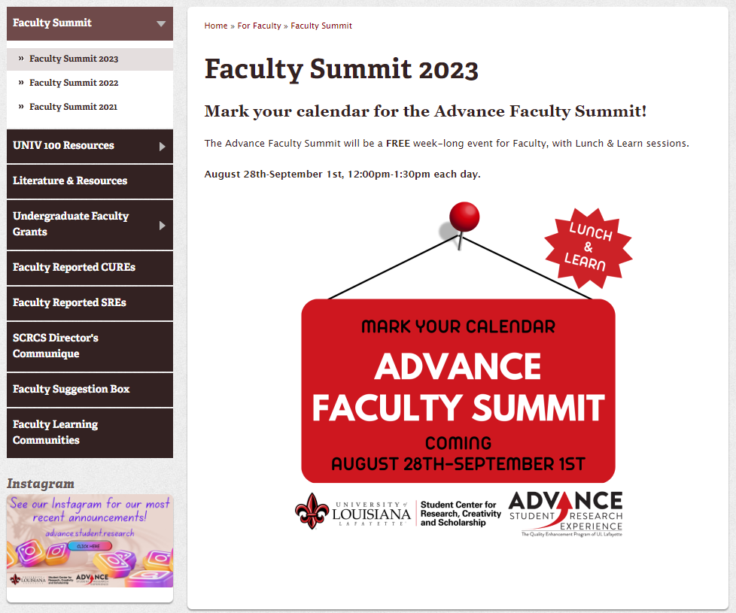
Fall, 2023

Slide 15
Fall, 2023
November 3rd & 4th , 2023

Slide 16
Thank you !
Any Questions?

