Slide 1













RESEARCH, INNOVATION & SCHOLARLY EXCELLENCE (RISE) UL: VISION 2030
R AMESH KOLLURU, PHD KUMER P. DAS, PHD
GEOFF STEWAR T, PHD AUGUST 15 , 2023
A CARNEGIE R1
TOP-TIER
RESEARCH UNIVERSITY

Slide 2
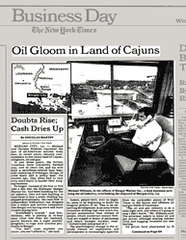

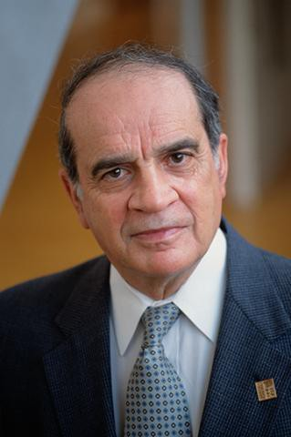




ECONOMIC DOWNTURN, 1980’S
University of Southwest Louisiana President Dr. Ray Authement Response to Economic Downturn
The New York Times, August 3, 1982
Unemployment in
Double Digits through 1988
Louisiana Procurement and Technical Assistance Center
Manufacturing Extension Partnership of Louisiana
Louisiana Small Business Development Center

Slide 3


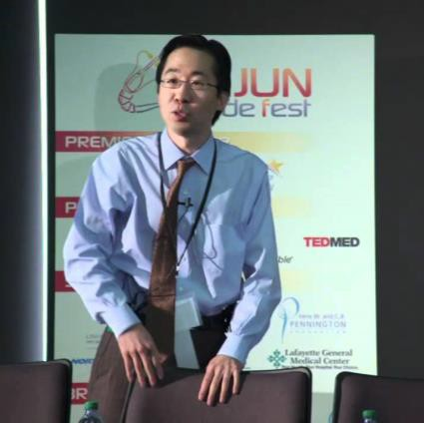
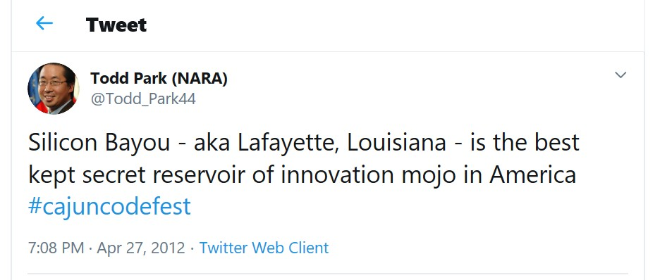
REGIONAL ECONOMY NOW
Self-Reliant, Innovative, Entrepreneurial, and Tech-Savvy:
  LUS in 1896; LUSFiber in 2005; 68% Referendum; $125M
  “Fastest Home Internet in the World”, per Open Technology Institute
  Nation’s first Gigabit Peer-to-Peer Network
  #1 Rank Tied with Seoul, Tokyo and Hong Kong
Quality of Life:
  Capitalize on unique and authentic Cajun-Creole Culture and Heritage
  “Happiest City in the US”, as Ranked by CDC & WSJ, 2015
University’s Strategic Investments:
  Computing, Clean Energy, and Life Sciences
Aligned and Allied:
  LEDA; One Acadiana, Acadiana Planning Commission, LCG
Diversification of Regional Economy:
  IT, Energy, Healthcare

Slide 4
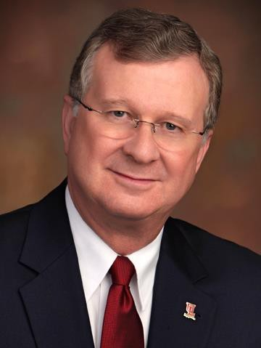

OUR PROMISE & COMMITMENT TO ECONOMIC PROSPERITY
“Research for a Reason” is more than a tagline. It is our promise to
deliver on our “public good” mission.
Dr. Joseph Savoie, President
Our Approach: SOCIAL MOBILITY & ECONOMIC PROSPERITY THROUGH RESEARCH
Grow Research Capacity To Impact Economy & Society
  Focus on Diversity, Equity and Inclusion;
  First-generation Students & Social Mobility
New Model of Competitiveness: Facilitate “Brain Sharing” with Industry
Align with Local, Regional and State Economic Development Strategy
Recruit New Business & Industry, while Supporting Entrepreneurs

Slide 5
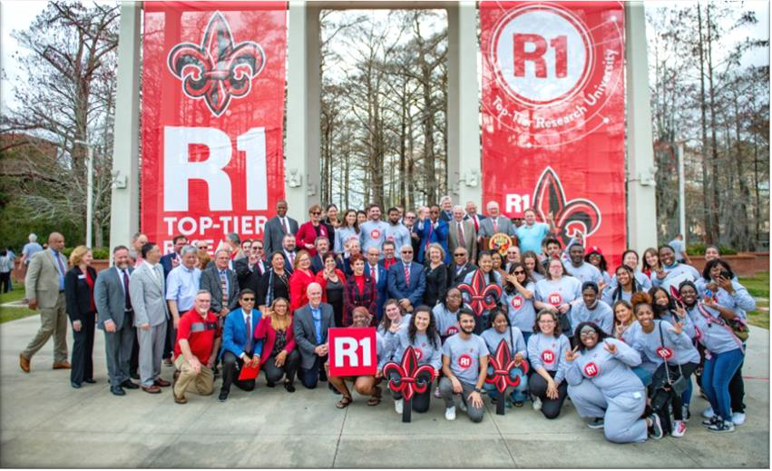
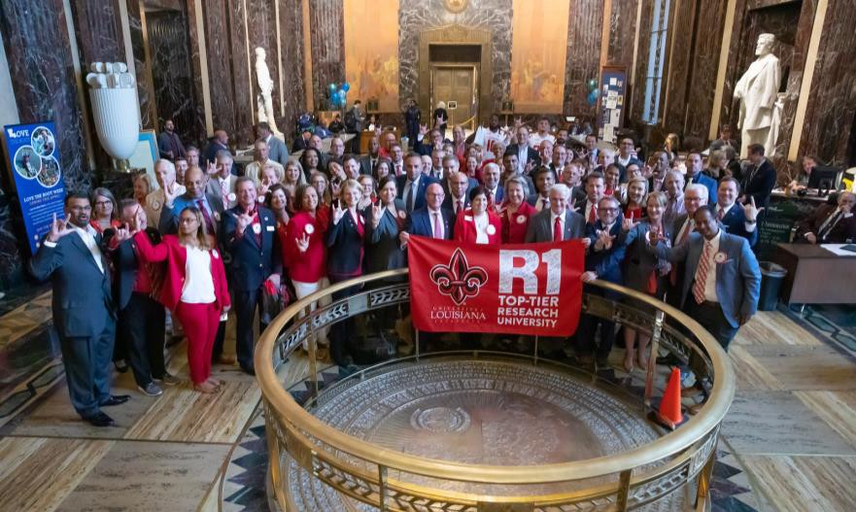
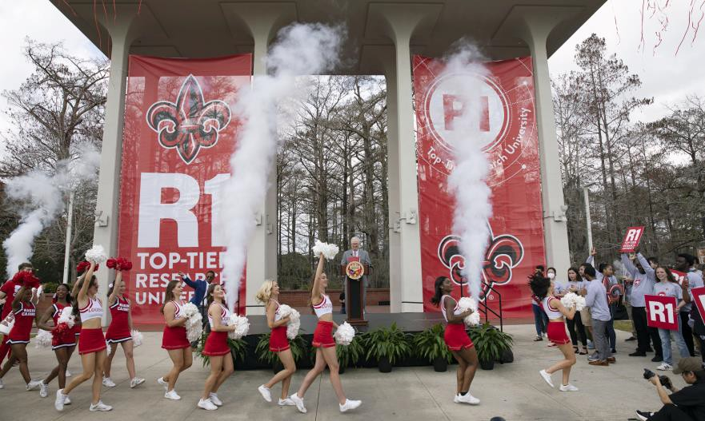
December 14, 2021

Slide 6

$ STEM R&D EXPENDITURES
$ NON-STEM R&D EXPENDITURES
# POST-DOC & NON-FACULTY RESEARCHERS
Carnegie Classification Parameters
# FACULTY IN RANK
# DOCTORAL DEGREES (HUMANITIES)
# DOCTORAL DEGREES (LIBERAL ARTS)
# DOCTORAL DEGREES (STEM)
# DOCTORAL DEGREES (OTHERS)

Slide 7

TRANSITION FROM R2 TO R1 IN 2021
Baylor University
Colorado School of Mines
Kent State University at Kent
North Dakota State University-Main Campus
Ohio University-Main Campus
The University of Montana
The University of Texas at San Antonio
University of Alabama in Huntsville
University of Denver
University of Louisiana at Lafayette
University of Maine
University of Maryland-Baltimore County
University of Memphis
Utah State University
R1 in 21:
$144M in R&D Expenditures
163 Post-Doc/Non-Faculty Researchers
60 Doctoral Students

Slide 8
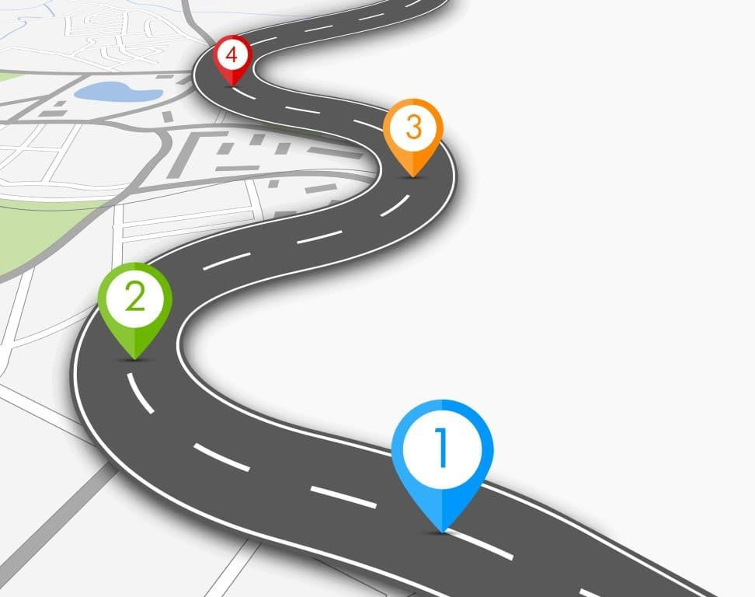
STATISTICAL MODEL FOR CARNEGIE RANKINGS
Uses seven primary variables (weights)
  STEM Doctoral Degrees (0.909)
  S&E R&D Expenditures (0.899)
  Post-doctoral/Ph.D. Non-Faculty Researchers (0.894)
  Doctoral Degrees: Social Sciences (0.864)
  Doctoral Degrees: Humanities (0.839)
  Non-S&E R&D Expenditures (0.817)
  Doctoral Degrees: Other Fields (0.621) PLUS
2018
63%
2015
38%
2010
0.5-1%
A Key Variable: Number of Faculty FTE in Rank, used to convert other 7 into Per Capita values.

Slide 9
Students
Faculty
Why R1?
Staff
Community Global Society

Slide 10
Distribution of Institutions and Enrollments
 | Institutions |  | Enrollment
Category | Number | Percent | Total | Percent | Average
Doctoral Universities: Very High Research Activity (R1) | 146 | 3.7% | 3,809,417 | 19.0% | 29,080
Doctoral Universities: High Research Activity (R2) | 134 | 3.4% | 1,948,172 | 9.7% | 14,431
Carnegie Research University Classification

Slide 11
2021 Classification Data | S&E R&D ($Thousands) | Non- S&E R&D ($Thousands) | NFR/ Post- Doc | Social Science Doctoral Degrees | Humanities Doctoral Degrees | STEM Doctoral Degrees | Other Doctoral Degrees
UL | $138,225 | $25,845 | 163 | 0 | 13 | 24 | 19
Average of R1 Institutions | $439,401 | $28,536 | 561 | 32 | 39 | 194 | 76
Average of Peer R1 Institutions | $142,489 | $15,690 | 135 | 15 | 16 | 77 | 45
Average of R2 Institutions | $42,387 | $4,358 | 30 | 5 | 4 | 23 | 36
Carnegie Research University Classification

Slide 12
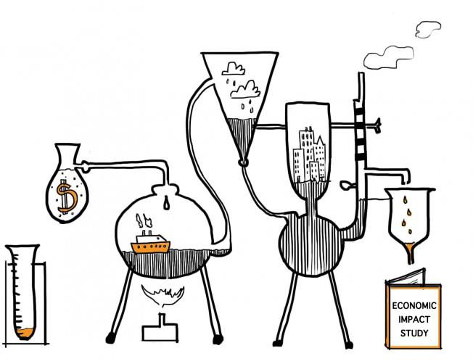
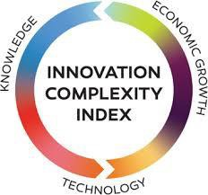
THE IMPACT OF R1
ECONOMIC IMPACT
Economists estimate that every $10 million in research
expenditures generates more than 300 new jobs and adds more than $8 million to the regional economy.
GIFT IMPACT
In FY2018 the top 10% of R1 publics attracted over $380M in new gifts, while the bottom 10% of R1 publics attracted about $10M in new gifts
in FY2018.
FY2018 gifts per full-time equivalent student averaged about $10K for an R1 institution and it was about $5K for an R2 institution.

Slide 13



RESEARCH OUTCOMES: NATIONAL SCIENCE FOUNDATION RANKINGS
FY 2022:
$205M
FY 2013
177
FY 2021
135

Slide 14



RESEARCH & SOCIAL MOBILITY OUTCOMES
RESEARCH RANKINGS
INDUSTRY FUNDED RESEARCH RANKINGS
FY 2013
#177
$62M
FY 2020
#135
$181M
FY 2019
#10
FY 2020
#7
#26
for Increasing Graduation Rates of Minority Students
Four Years in A Row
for Advancing Excellence in Diversity

Slide 15






Current Research Areas of Focus
COMPUTING & SECURITY
ENERGY & SUSTAINABILITY
LIFE SCIENCES & PUBLIC HEALTH
ADVANCED MATERIALS & MANUFACTURING
CLIMATE CHANGE & MANAGEMENT
HUMAN, COMMUNITY, & ECONOMIC DEVELOPMENT

Slide 16





FOCUS: COMPUTING & SECURITY
Department of Computer Science/Center for Advanced Computer Studies: Nation’s first Master’s degree in Computer Science in 1962
Alpha Chapter of ACM in 1961
CACS – Top CS Graduate programs in the US
School of Computing & Informatics: Significant growth to meet demand for graduates
Informatics Research Institute: NSF Center for Visual and Decision Informatics: Nation’s only NSF Center of Excellence in “Big Data” since 2012
Informatics Research Institute: Center for Critical Infrastructure Cybersecurity, Alternate State EOC, LA Business EOC, Homeland Security and Emergency Preparedness
Governor’s Louisiana Cybersecurity Commission: Drs. Arun Lakhotia and Ramesh Kolluru

Slide 17



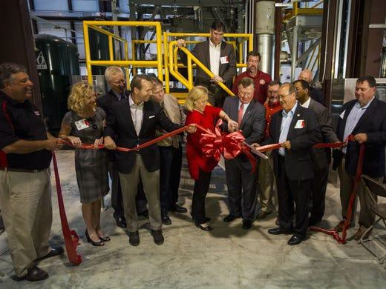


FOCUS: ENERGY & SUSTAINABILITY
Energy Institute of Louisiana: Expertise in Oil & Gas, Renewables, Carbon Capture, Green Hydrogen, Biofuels, Green Chemicals and Solar Energy Technologies
Institute for Materials Research & Innovation: Over $25M of DOE and NSF funding in CCUS, Energy Storage, Green Hydrogen Production.
Governor’s Climate Taskforce: Dr. Terry Chambers
Taskforce Science Advisory Board: Drs. Mark Zappi, Peng Yin and Vijay Gopu
School of Geosciences: Students win the “Imperial Barrel Award” competing against universities from the US, and across the globe - 3 YEARS IN A ROW!
We are #1 in #2 Business!

Slide 18


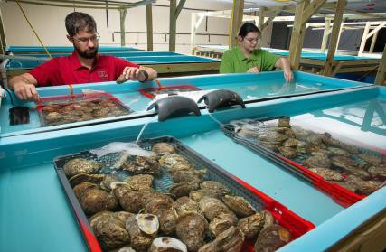





Focus: Life Sciences & Public Health
New Iberia Research Center: Nation’s Largest Non-Human Primate Center led by Dr. Francois Villinger
Animal Safety: Certified by National & Global Organizations for Safety and Ethical Treatment of Animals
Contract Research Organization (CRO): Over 40 Companies, Three Decades
Vaccines & Therapeutics Developed & Tested at NIRC
Over 12 COVID-19 Vaccines and Therapeutics
Antiviral Agents: HIV, HCV, HBV; Monoclonal Antibodies, mRNA
Vaccines: Mumps, Measles, Chicken Pox, Ebola, AIDS, RSV, Zika, Dengue
LO-SPAT Project: Develop oyster populations that can survive, grow, and reproduce in challenging (low-salinity) environments, led by Dr. Beth Stauffer
Universities, Industry and Government partnership to address the decline of oyster populations due to ongoing coastal climate change.

Slide 19
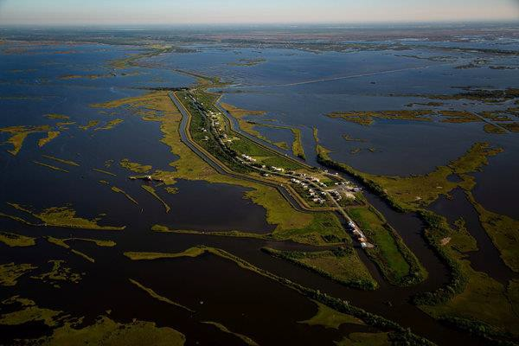
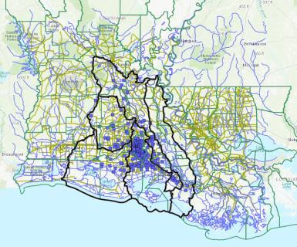
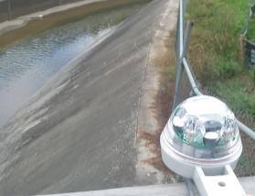
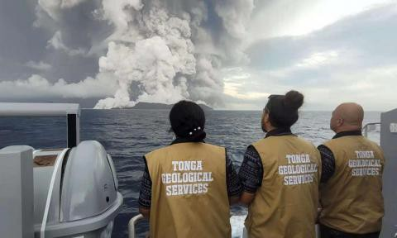
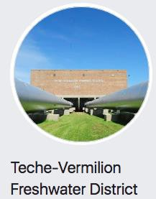

Focus: Climate Change
Pre-eminent Biology, Engineering, Environmental and Social Science academic programs across the university.
Institute for Coastal & Water Research (ICaWR): Louisiana Watershed Flood Center, coastal and inland water management
Louisiana Watershed Initiative: Dr. Emad Habib, Technical Design and Quality Team Lead
Isle de Jean Charles in Southeastern Louisiana. A
$48 million federal grant has
been allocated to resettle its
residents.
PhD program in Earth and Energy Sciences: Dr. Brian Schubert – Climate Change Scientist and coordinator of the PhD program.
Isle de Jean Charles: Documenting the first Climate Change refugees in the US

Slide 20

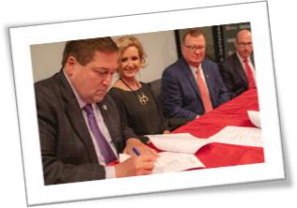

Focus: Human, Community, Economic Development
B.I. Moody College of Business Administration, College of Liberal Arts & College of Education: Focus on Entrepreneurship; Community, & Economic Development
Louisiana Entrepreneurship & Economic Development (LEED) Center: An EDA University Center: Dr. Geoff Stewart
Seafood Supply Chains in Coastal Parishes: Supply chain mapping – from Water to Waiter; Boat to Throat; USDA Rural Development and Lt. Gov.
Nungesser
Center for Louisiana Studies: Dedicated to researching, publicizing, promoting,
and preserving Louisiana’s cultures and history led by Dr. Joshua Caffery
College of Education: Driving the development of teacher preparation and doctoral students in Educational Foundations and Leadership - Drs. Dianne Olivier, Richard Fossey, and others.

Slide 21




VISION 2030
TRANSFORMATION TO THE NEXT FRONTIER
INNOVATION & RESEARCH ADVISORY COUNCIL
MAXIMIZE RESEARCH & INNOVATION OUTCOMES TO BROADEN ECONOMIC IMPACT
ADDRESS GRAND SOCIETAL CHALLENGES
BUILD THE RIGHT RESEARCH & INNOVATION INFRASTRUCTURE
WITH DIVERSITY, EQUITY, AND SUSTAINABILITY AS NON-NEGOTIABLE CORE VALUES

Slide 22




WHAT’S NEXT: COMPUTING & SECURITY
NSF Center for Applied AI:
Continue to define the future of Computing, AI, Machine Learning and Cybersecurity
Lead a National Center of Excellence with Industry and Universities
Center of Excellence for Cyber-Physical Systems Security
University Common – Proposed Headquarters for the 256th Battalion of the Louisiana National Guard
Recruit Federal Contractors (for DOD, NSA, DHS) by offering EMP Resilient Utility Infrastructure.

Slide 23



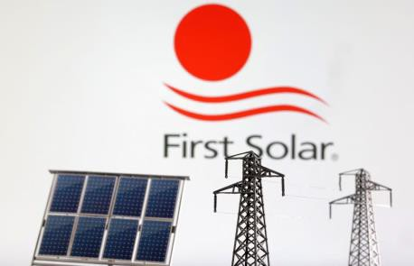
WHAT’S NEXT: ENERGY & SUSTAINABILITY
H₂theFUTURE & Decarbonization:
US Economic Development Administration (EDA) Build Back Better:
Green Hydrogen Center of Excellence
R&D Hub for Solar, Biofuels, CCUS and Hydrogen;
Transition Fossil-Fuel States from Hydrocarbons to Clean Energy
C1 Extension Services
First Solar chooses LA to build US panel factory
A $1.1B Investment
LNG Center of Excellence:
In partnership with McNeese, LNG Industry, US Department of Transportation

Slide 24


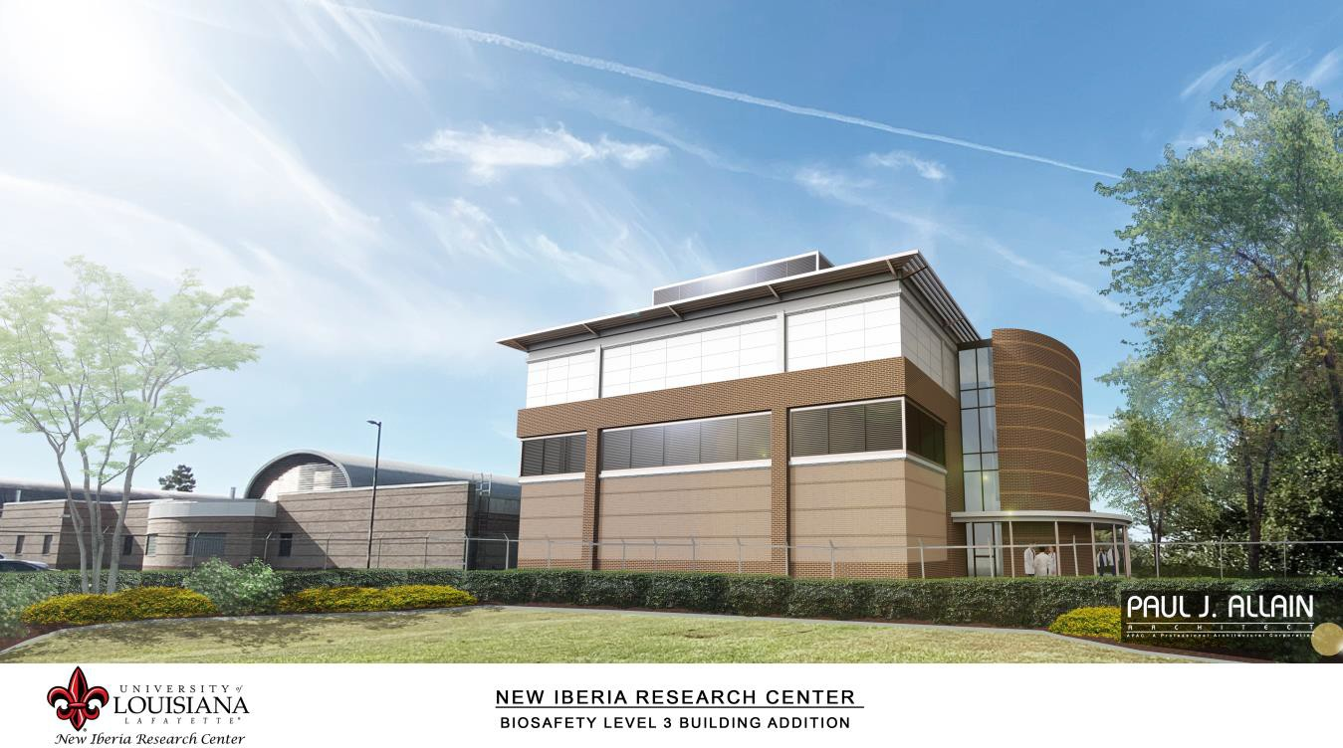
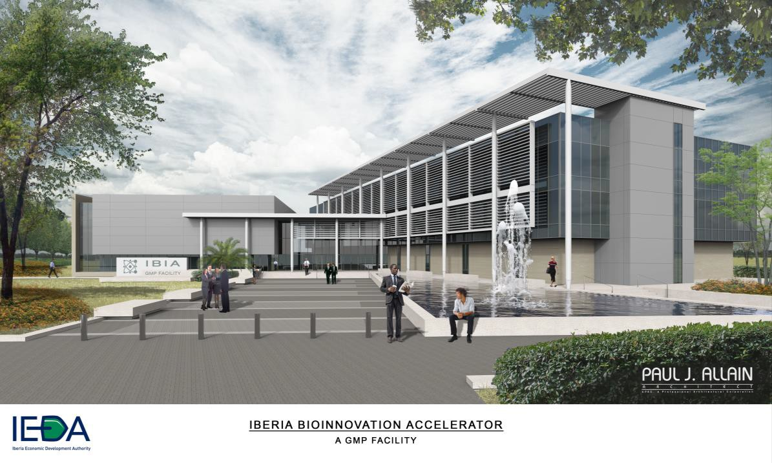
WHAT’S NEXT: LIFE SCIENCES
Pre-clinical Trials For Infectious Diseases Contract Bio-pharmaceutical Manufacturing

Slide 25
OFFICE OF VP FOR RESEARCH, INNOVATION, AND ECONOMIC DEVELOPMENT
WHAT OVPRIED CAN DO FOR YOU
UL's research endeavors span multiple offices, institutes and centers.
OVPRIED introduces and executes policies and procedures with the guidance of advisory council and other constituents.
It supports faculty in pre- and post- award activities. Supports maintaining research integrity
Manages intellectual property of research done in with the University
Brings multi-institutional, multi-disciplinary large scale research collaborations
YOUR SUPPORT TEAM
Dr. Ramesh Kolluru
Vice President
Dr. Kumer Das Assistant Vice President
Dr. Geoff Stewart
Assistant Vice President
Ms. Christine Payton
Communication Specialist
Ms. Tatum Moss Event Coordinator
Ms. Katherine Small
Economic Development Coordinator
Ms. Rachael Ard Executive Assistant
Ms. Elaria Abader
Research Operations Coordinator
Dr. Rahul Chatterjee
Research Associate

Slide 26
OFFICE OF RESEARCH & SPONSORED PROGRAMS (ORSP)
ORSP SUPPORT SERVICES
ORSP is a professional service office, also commonly referred to as the Pre-Award Office
Support and facilitate the overall grant process, while balancing the need for institutional and sponsor regulatory compliance
ORSP assists university investigators:
Identify funding opportunities
conceptualize and prepare grant proposals
secure institutional approval for proposals
submit proposals for funding
YOUR SUPPORT TEAM
Dr. Jessica Baudoin ORSP Manager
Ms. Yue Yang
Senior Pre-Award Grants Specialist
Ms. Dominique Klingman
Junior Pre-Award Grants Specialist
Ms. Ruth Zhang
Junior Pre-Award Grants Specialist
Ms. Ciara Crochet
Junior Pre-Award Grants Specialist

Slide 27
PRE-AWARD PROCESS & WORKFLOW
Identify Funding Opportunity
Draft proposal; Seek assistance from ORSP
Route proposal to PI and Co-PI Dept. Heads and Deans
Submit full draft of proposal to ORSP at least three working days prior to agency deadline
Work with Pre-Award Specialist to review and revise proposal in accordance with federal, state, university, and agency guidelines
ORSP routes proposal for
administrative approval
Once proposal is approved, ORSP makes official submission on PI’s behalf

Slide 28
OFFICE OF INNOVATION MANAGEMENT (OIM)
WHAT OIM CAN DO FOR YOU?
OIM manages Intellectual Property (IP) of research done in with the University
Monitors the creation of IP in every department across UL
Secures the appropriate protections for IP
YOUR SUPPORT TEAM
Noah Bergeron, MS Associate Director
Trademarks
Copyrights
Patents
Accelerates the movement of IP from the laboratory to the marketplace (via startups and/or licensing of technology to others)
Fosters and builds new relationships with industry to enable research or service agreements

Slide 29










FROM IP TO PATENT TO LICENSE AGREEMENT
Sponsor Agency
No pre-existing agreement to license/commercialize
Funding
University pays for patent
IP
Disclosure
Patent Application
Licensing may occur long after research concludes
Commercial Company
Issued Patent
PI & Inventor Team
License Agreement

Slide 30

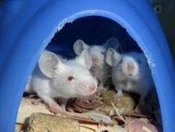


OFFICE OF RESEARCH INTEGRITY (ORI)
ASSISTANCE WITH COMPLIANCE IN
Responsible Conduct of Research
Research Misconduct
Financial Conflict of Interest
Research involving
Human Subjects
Animal Subjects
Recombinant DNA
Pathogens
Radioactive materials or radiation producing equipment
Export Controlled Technology
Data Management Plans
Foreign Trainees
Import of Biological Materials
YOUR SUPPORT TEAM
Robin Schneider-Broussard, PhD Director
Stephannie Ruiz, EdD
Research Compliance Coordinator

Slide 31
SPONSORED PROGRAMS FINANCE ADMINISTRATION & COMPLIANCE (SPFAC)
SPFAC PROVIDES
Seamless transition from pre-award to post award activities
Post award management and financial oversight while ensuring compliance with federal regulations and adherence to state and university policies for all sponsored activities
YOUR SUPPORT TEAM
Judith Maina
Director
Joseph Derigo Natalie Bienvenu Elena Thomas Justice Anthony Brittany Gray
Post Award Specialist
SPFAC'S RESPONSIBILITIES
Contact review and negotiation
Research accounting and financial reporting Time and effort certifications
Subaward management
Training and education in the administration of sponsored projects Audit responsibilities
Markashia Brown
Manager, Research Accounting Meagan Armentor
Jacob Maxey
William David Research Accountant
Melissa Richard
Research Fund Analyst

Slide 32
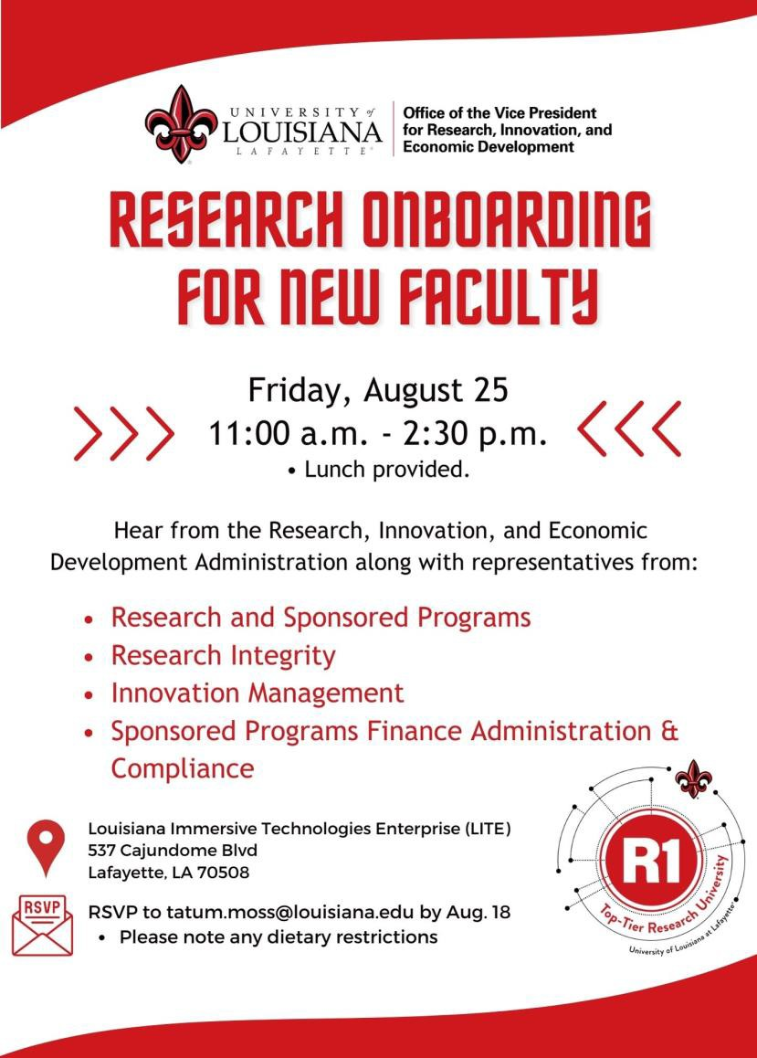
RESEARCH ONBOARDING FOR NEE FACULTY

Slide 33


Questions?
Ramesh.Kolluru@louisiana.edu
Cell: 337-739-1579
Kumer.Das@louisiana.edu Cell: 409-434-8460
Geoffrey.Stewart@louisiana.edu
Cell: 337-212-1185

