Slide 1
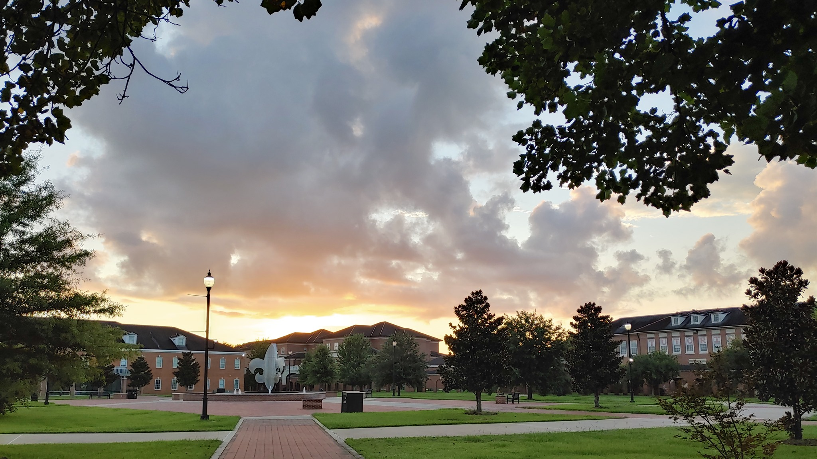
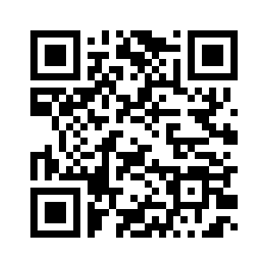
UL Lafayette
Faculty Senate
https://facultysenate.louisiana.edu
Works with the administration on addressing academic standards, student experience, institutional governance, and organizational policies.
Senators represent all ranks, departments, colleges.
Executive Committee
President: Philip Auter -- philip.auter@louisiana.edu | 337-482-6106
Vice President: Leah Orr -- leah.orr@louisiana.edu | 337-482-5463
Secretary: Kelly Robinson -- kelly.robinson@louisiana.edu | 337-482-5705
Elected Rep: Febee Louka -- febee.louka@louisiana.edu | 337-482-6900
Senators work for you.

