Slide 1
Division of
Academic Affairs
~~~~~~~
Office of Student and Faculty Excellence
Dr. Dianne F. Olivier
Associate Vice President for Academic Affairs
dianne.olivier@louisiana.edu
academicaffairs.louisiana.edu

Slide 2
Academic Affairs
The Academic Affairs Division promotes a learning environment designed to enhance student outcomes by further developing academic programs, fostering integration of research in academic programs to promote undergraduate research opportunities and support faculty research, creating strategies to support faculty development, and promoting faculty engagement in academic governance.

Slide 3
Academic Affairs Mission
The Academic Affairs Division promotes effective teaching and learning by developing excellent undergraduate and graduate academic programs, facilitating faculty development and achievements, and enabling relevant research, while supporting initiatives to meet the needs of students and citizens of the state, the nation, and the global community.

Slide 4
Academic Affairs Administrative Offices
Office of the Provost and Vice President for Academic Affairs
Dr. Jaimie Hebert
Office of Student and Faculty Excellence
Dr. Dianne F. Olivier, Associate Vice President
Office of Institutional Effectiveness
Dr. Blanca Bauer, Associate Vice President
https://academicaffairs.louisiana.edu

Slide 5
Academic Affairs Units
Oversees all Colleges and Departments
Academic Success Center
Continuing Education
Global Engagement
Graduate School
Hillard University Art Museum
Louisiana Educate Program
Office of Academic Programs
Office of Distance Learning
Office of First Year Experience
Office of Institutional Assessment
Office of Institutional Research
Office of the University Registrar
Office of Planning & Academic Initiatives
Service Learning
Student Athlete Academic Center
Student Center for Research, Creativity, and Scholarship
The Learning Center
University Honors Program
University Libraries

Slide 6
Office of Student and Faculty Excellence (Office of Faculty Affairs)
Office of Student Success
Dr. Elizabeth Giroir
Student Center for Research, Creativity, and Scholarship
Dr. Sherry Krayesky-Self
University Registrar’s Office
Amy DesOrmeaux
Global Engagement
Dr. Gabriel Carranza
Community Service
Dr. David Yarbrough

Slide 7
Office of Student and Faculty Excellence
Academic Leadership (Deans, Department Heads/School Directors)
Academ (Faculty Management CV & Research)
Credential Verification
Committees and Councils (University Committees, Faculty Senate, DH Council, Deans Council, Associate Deans Council, Faculty)
Faculty/Student Awards & Honors (Chairs & Professorships, Eminent Faculty Awards, Outstanding Advisor Awards, Emeriti Faculty, Honors Convocation)
Faculty Development
Faculty Grants & Funding (Research Travel Grant & Funding Opportunities)
FLAC – Faculty Load and Compensation/PAFs
New Faculty (Orientation, Hiring)
SEIs – Student Evaluations of Instruction
Tenure & Promotion
Workload & Evaluations (Compensation)

Slide 8
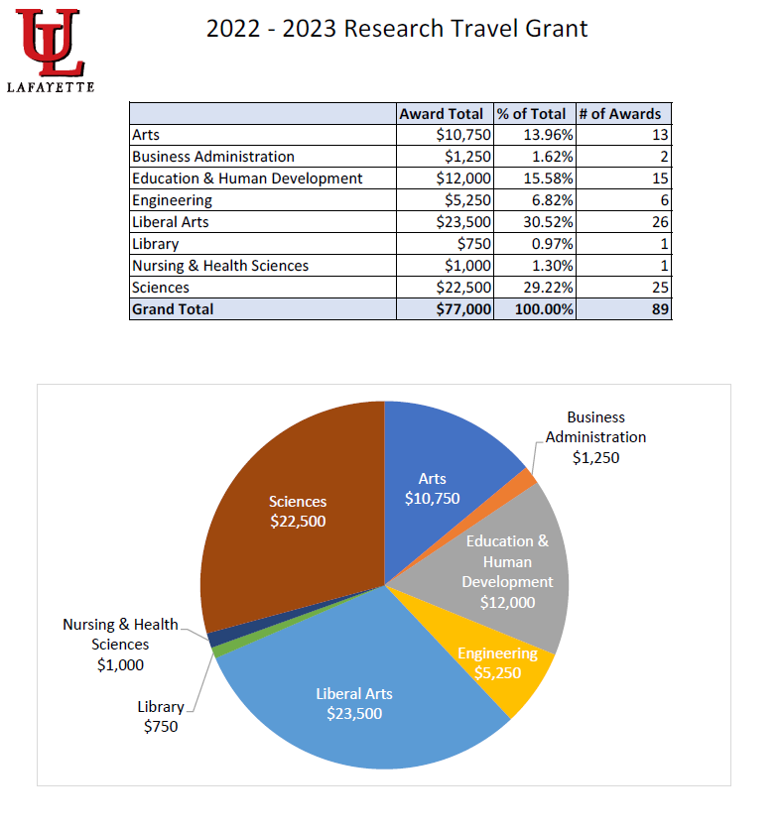

Slide 10
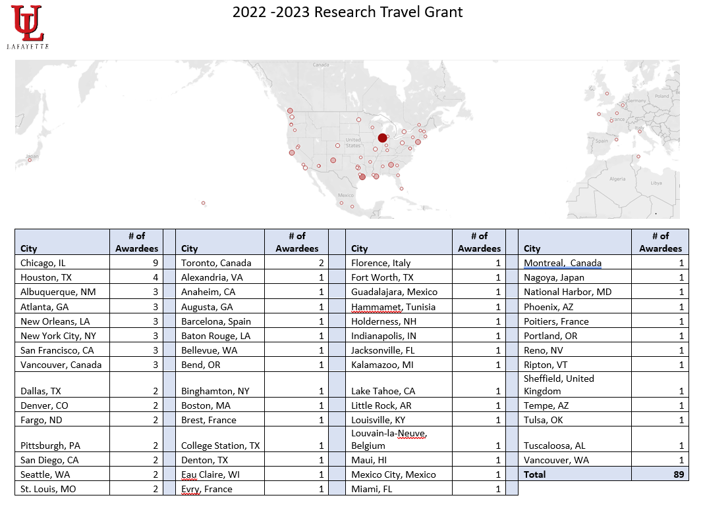

Slide 11
Contact Us
Dr. Dianne F. Olivier, Associate Vice President for Academic Affairs
Martin Hall 239
(337) 482-5308
dianne.olivier@louisiana.edu
Kathy Donham, Assistant to Associate Vice President
Martin Hall 239
(337) 482-5308
kathy.donham@louisiana.edu
Travis Carmouche, Support Technologist
Martin Hall 239
(337) 482-1149
travis.carmouche@louisiana.edu
Debra Broussard, Data Analyst
Martin Hall 221
337-482-6974
debra.broussard@louisiana.edu

Slide 12
New Faculty Sessions
New Faculty Orientation
September Session
Global Engagement
Service Learning
Teaching Strategies
Provost Breakfast
October 5 – 7:30-9:30 (Dupre Staff Lounge)
Social with the Provost
November 16 – 3:00-5:00 (Alumni House)

Slide 13
Thank you! Slides are available at the following QR code.

