Slide 1
New Investments
to support Faculty and Grad Student Scholarly Research and Development
NCFDD
INSTITUTIONAL MEMBERSHIP

Slide 3
The three-year NCFDD Institutional Membership--a $60,000 investment--is funded jointly by the Office of the Provost,
Office of the Vice President for Research, Innovation, and Economic Development,
and the Graduate School.

Slide 5
for all faculty members and graduate students

Slide 8
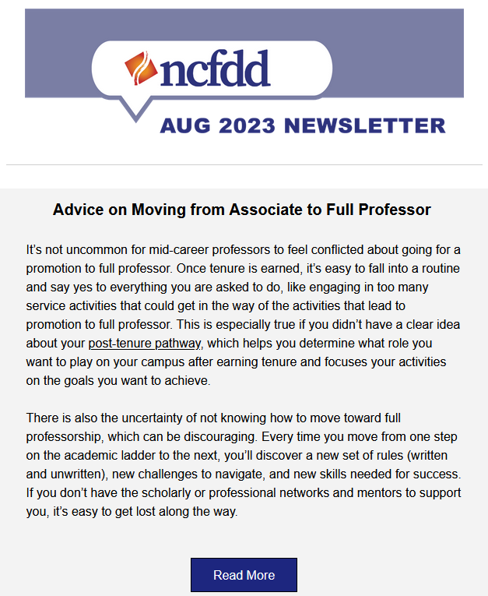

Slide 10
THE CHALLENGE IS SIMPLE.
Write for at least 30 minutes
every day - Monday through
Friday - for two weeks.
Writing, in this case, refers to
any scholarly activity ranging
from the spark of a new idea
to polishing a near-complete project (article, chapter, grant
proposal, exhibit, book
chapter, etc.).
https://www.facultydiversity.org/14-day-challenge

Slide 11
for advanced graduate students
Dissertation
Success Curriculum

Slide 12
isolation . perfectionism . procrastination procrastination
for advanced graduate students
Dissertation
Success Curriculum

Slide 13
for advanced graduate students
Dissertation
Success Curriculum

Slide 14
CURRENTLY AVAILABLE!

