Slide 1
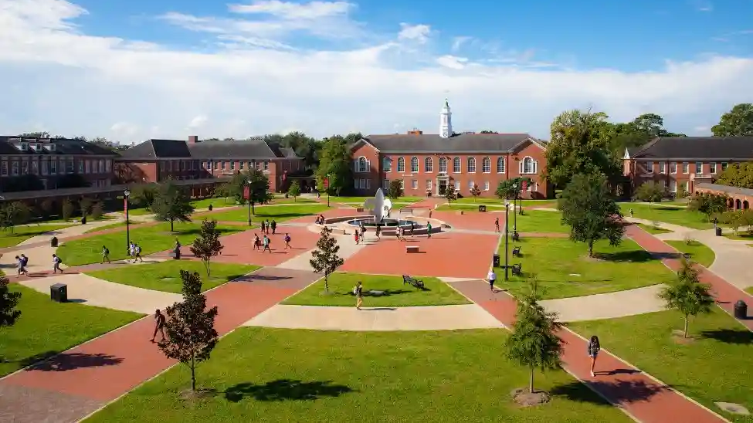
YOU BELONG HERE
UL Lafayette Office for Campus Diversity
Kiwana T. McClung, Assoc. AIA, NOMA
Chief Diversity Officer and Professor of Architecture
University of Louisiana at Lafayette

Slide 2
Guiding Principles
Our Mission
The Office for Campus Diversity's mission is to cultivates an inclusive learning environment that values different perspectives and promotes intercultural engagement.
Our Vision
We strive to create a diverse and inclusive community in which all members feel valued, respected, and able to reach their full potential.

Slide 3
A Campus Environment where everyone BELONGS

Slide 4
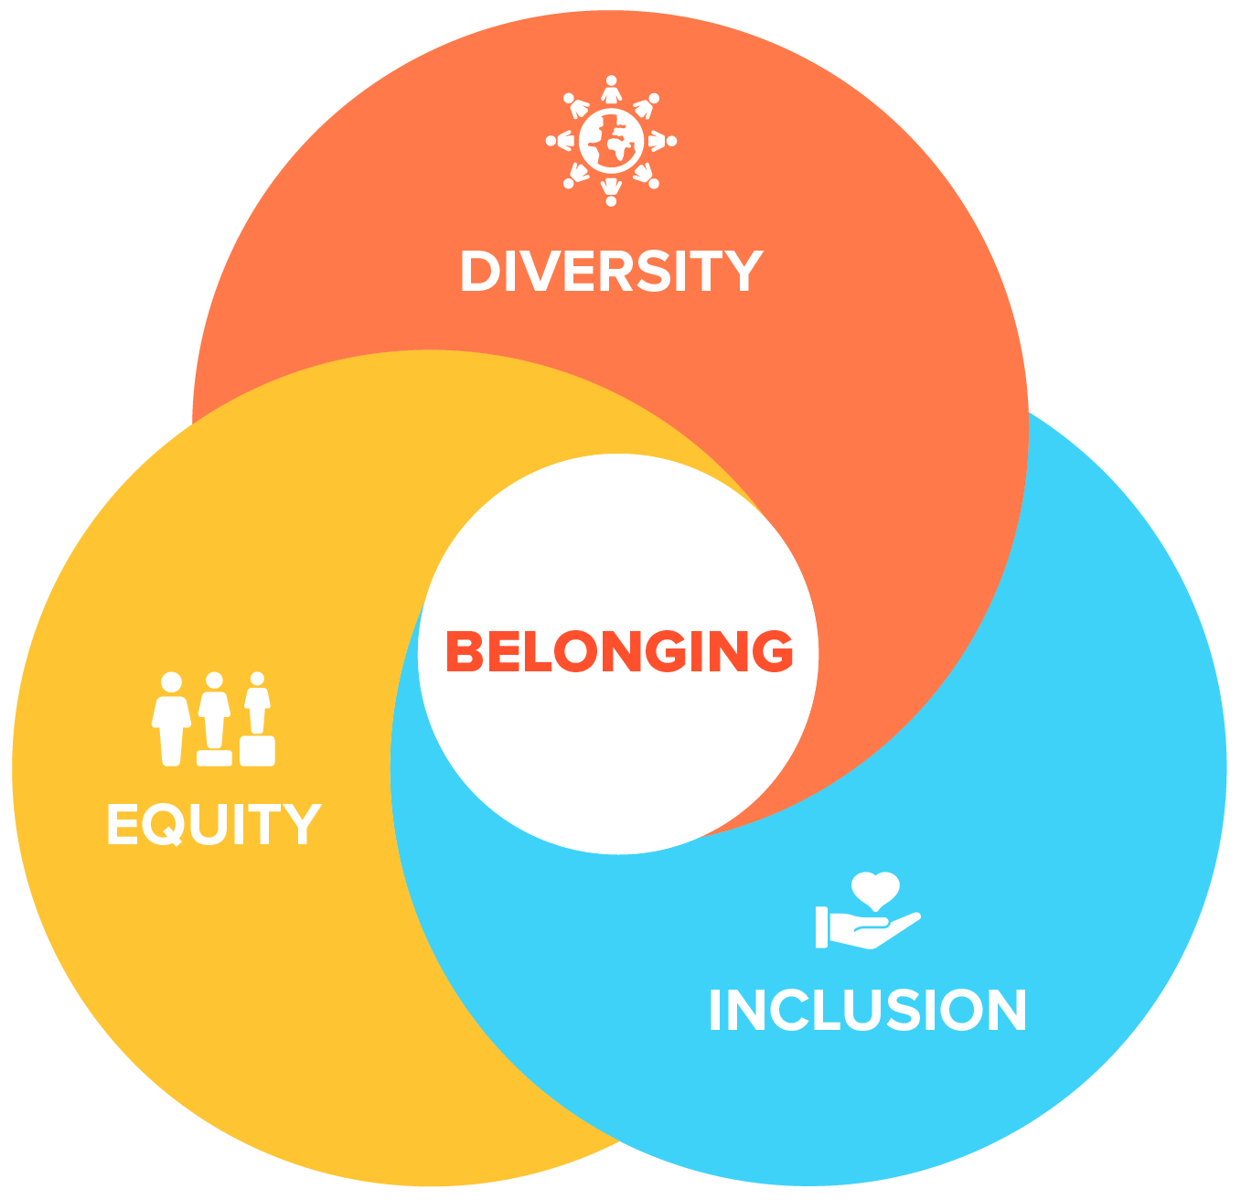
Belonging
"Belonging has to be something that everyone who works in an organization truly believes in, truly feels."
"It is everyone's job to make sure that everyone Belongs."
-Belonging: The Key to Transforming and Maintaining Diversity, Inclusion, and Equality at Work
Kathryn Jacob, Sue Unerman, and Mark Edwards

Slide 5
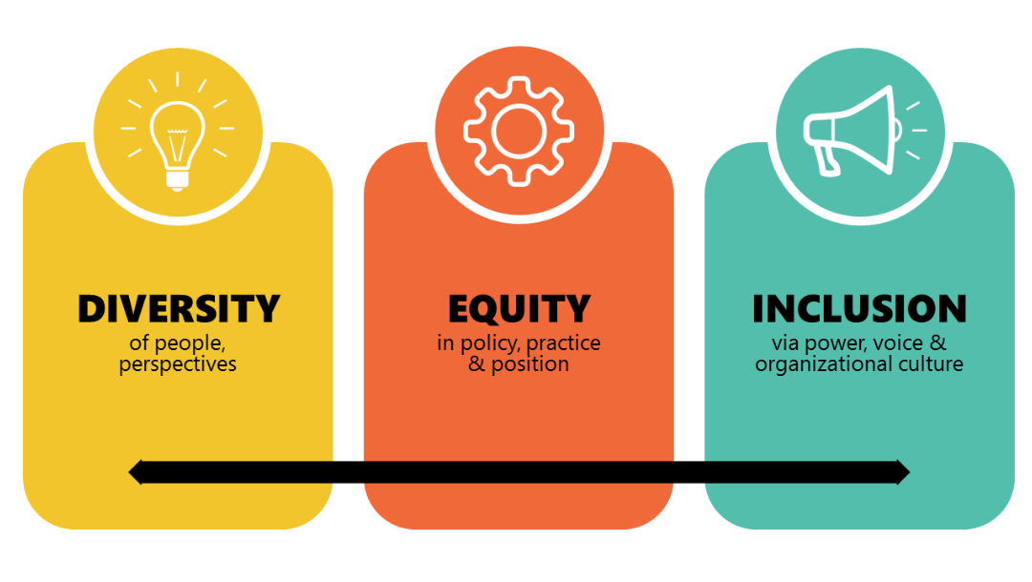
Equity & Inclusion

Slide 6
WHAT DO WE DO?

Slide 7
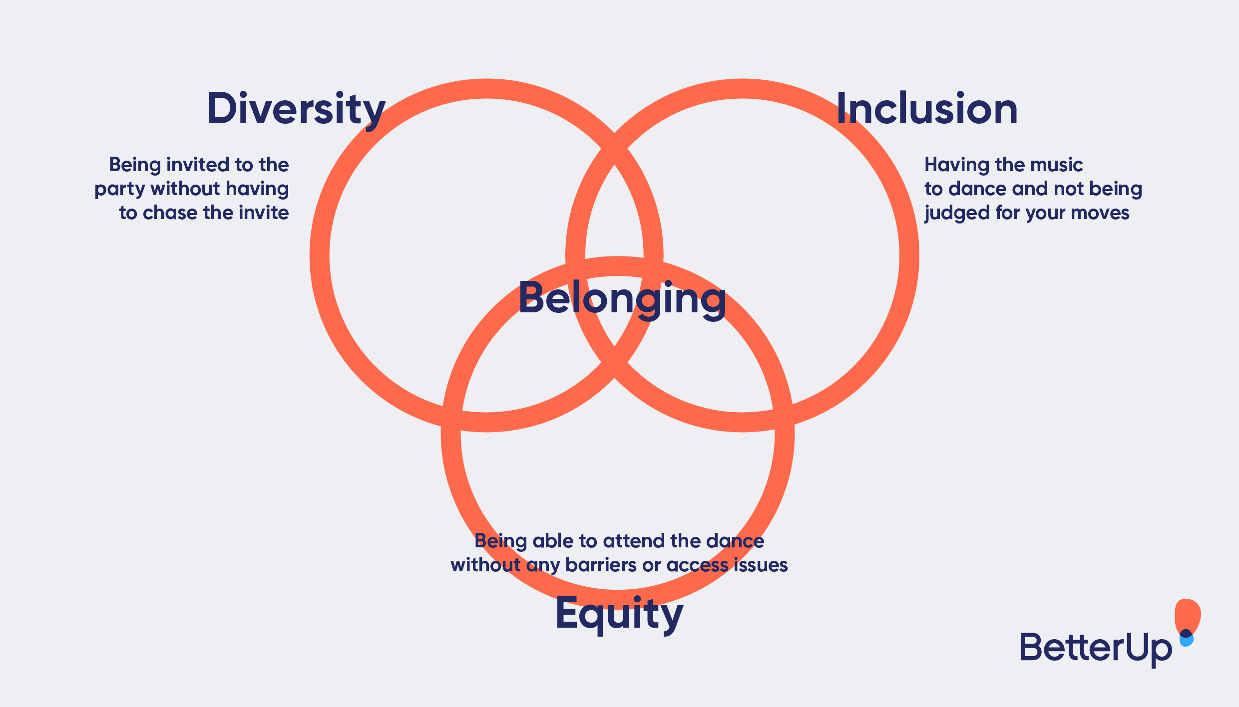
Promote a Culture of Belonging that is Actual, not Performative

Slide 8
Resources

Slide 9
Safety
Belonging
Engagement and Dialogue
Inclusive Teaching
Academic

Slide 10
Courageous Conversations

Slide 12
LGBTQ+ Resources & Support

Slide 14
Foster Inclusive Practices

Slide 15
Educating for Equity Fellows Program
A Cohort-Based Professional Development Program for Equity-Minded Teaching and Learning

Slide 16
First 2 Geaux
First Generation College Student Celebration

Slide 18
Support Affinity Groups

Slide 19
Celebrate Heritage

Slide 20
Community Outreach, Service, & Engagement

Slide 21
Assessment: Campus Climate Survey DEI Reports & Needs Assessments

Slide 23
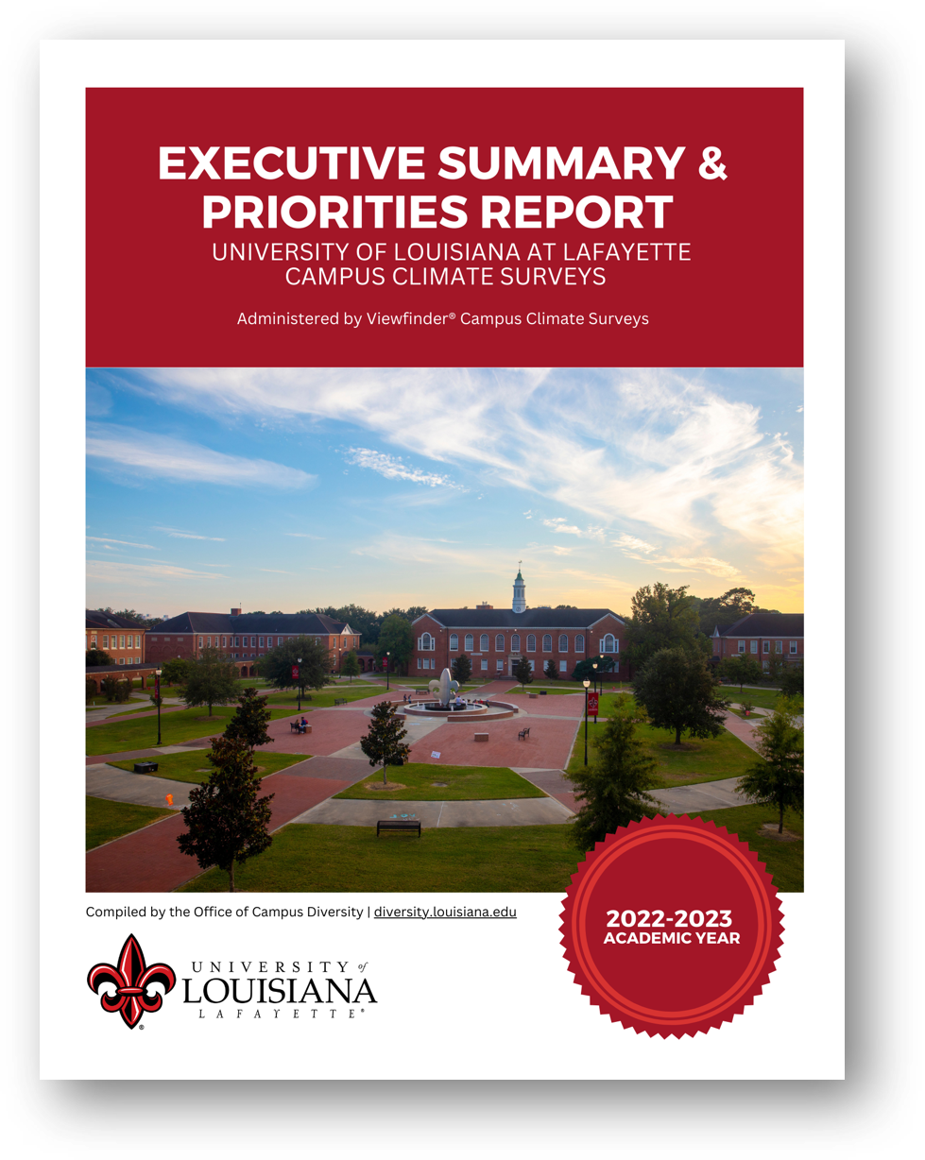

Slide 24
Diversity Advisory Council

Slide 26
Athletics Diversity and Inclusion Designee

Slide 28
Strategic Plan for Inclusive Excellence

Slide 30
Professional Development: Women's Leadership Conference

Slide 32
Faculty Diversity

Slide 34
Consulting

Slide 35
Campus Culture for Belonging

Slide 36
Other Activities

Slide 37
Other Activities
Gender-Neutral Restroom Campus Survey and Inclusive Signage Project
Conducted Bias and Other Specialize Trainings
Participated in Earth Week Celebrations with a research board focused on how climate issues affect diverse populations
Engaged in conflict resolution, mediation, and moderation for a number for campus groups and entities.

Slide 38
UL Lafayette DEI Successes
National Recognition (HEED Award - Last 6 Years)
Inclusive Teaching Initiatives – BoR Grant
Diverse Administration (3% Above National Average)
Improvements in Student Diversity
Engagement in Initiatives for Faculty Diversity
Faculty, Staff, and Student Affinity Groups
Notes:
https://www.zippia.com/higher-education-administrator-jobs/demographics/
https://www.equityinhighered.org/indicators/postsecondary-faculty-and-staff/proportion-of-white-college-and-university-administrators/

Slide 39
Other Considerations
Accrediting Bodies
2022 SACSCOC Annual Meeting in Georgia will include a focus on:
"Motivating intentional diversity, equity, and inclusion practices within strategic plans, accreditation systems, and institutional practices."
Most of the accrediting bodies for the accredited programs at UL Lafayette require explanations of initiatives and metrics for diversity, equity, and inclusion issues addressing faculty, students, and curriculums.
Notes:
https://sacscoc.org/2022-call-for-proposals/

Slide 40
Other Considerations
Governing Bodies
UL System Board of Supervisors
Report and Recommendations – Task force on Inclusion in the Workplace (2019): Cultural Competence, Recruiting, Hiring & Retaining, Professional Development & Leadership Training, and Athletics
Louisiana Board of Regents
The Board of Regents will lead the way in developing and implementing key initiatives to eliminate performance gaps, bring equity, and provide opportunity and social mobility for underserved Louisiana residents.
Notes:
https://s25260.pcdn.co/wp-content/uploads/2020/06/Taskforce-Report-Final-v3-April-2019-1.pdf
https://masterplan.regents.la.gov/home/educate/closing-louisianas-achievement-gaps/

Slide 41
Questions?
UL Lafayette Office for Campus Diversity
Diversity.louisiana.edu | diversity@louisiana.edu
Follow us on social media using hashtags #ULdiversity, #inclusiveUL and #ULwomenlead.
Facebook: @ULcampusdiversity Instagram: @uldiversity Twitter: @ULdiversity

